Slide 1
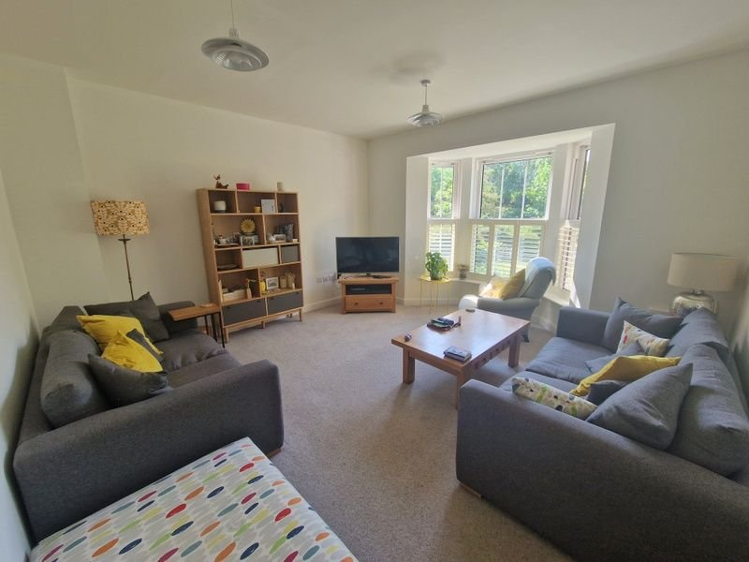
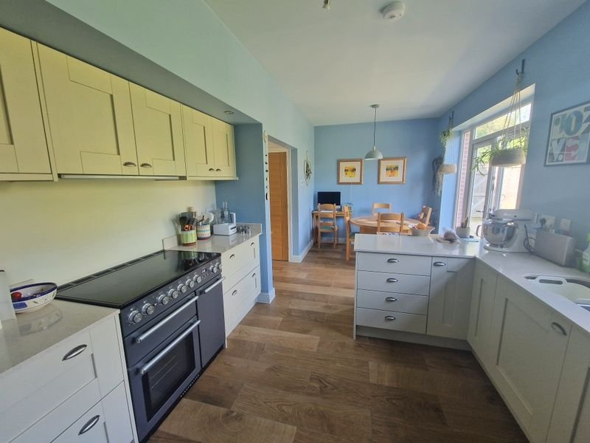
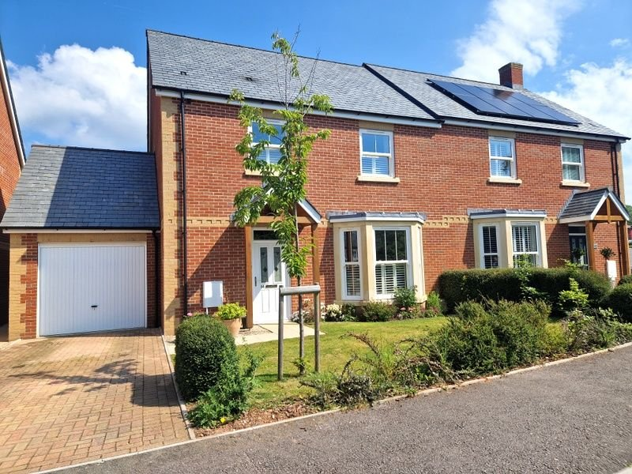
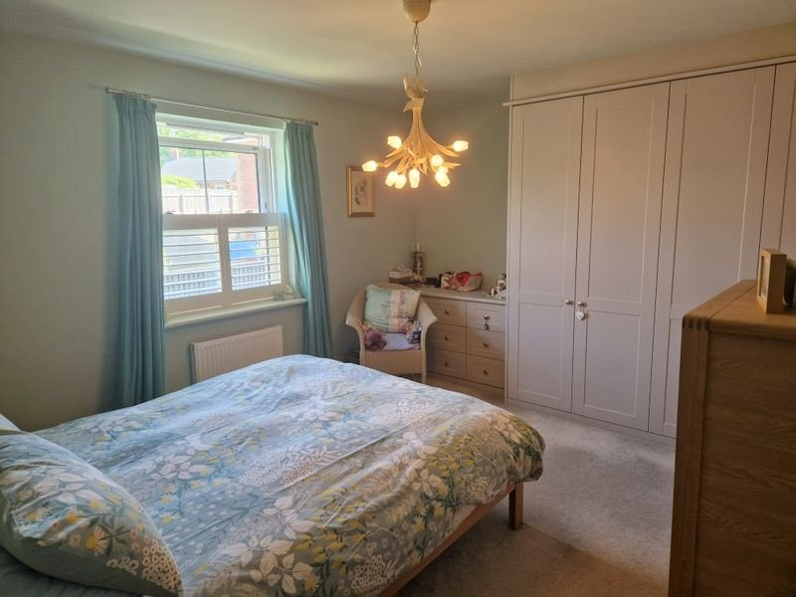
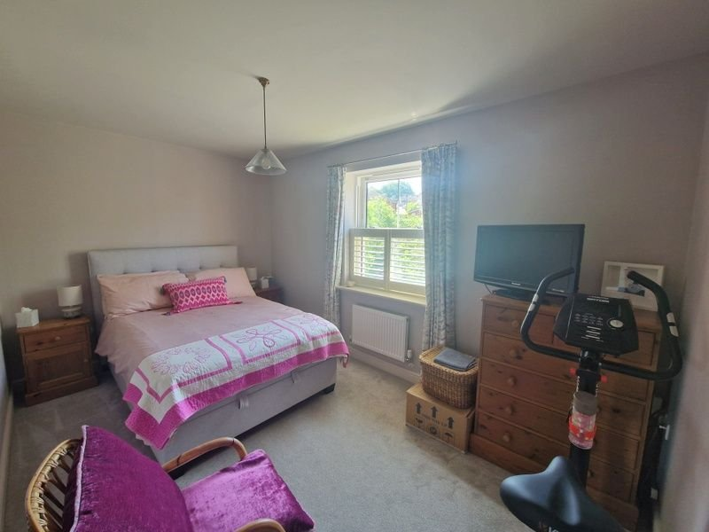
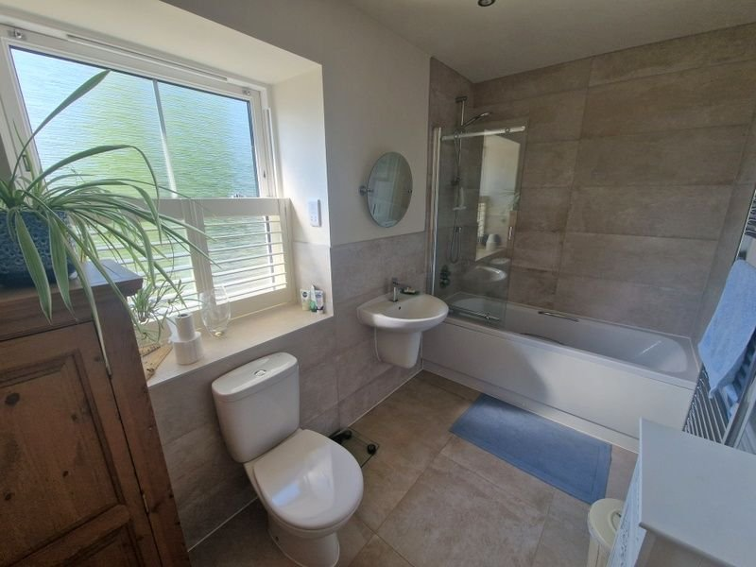
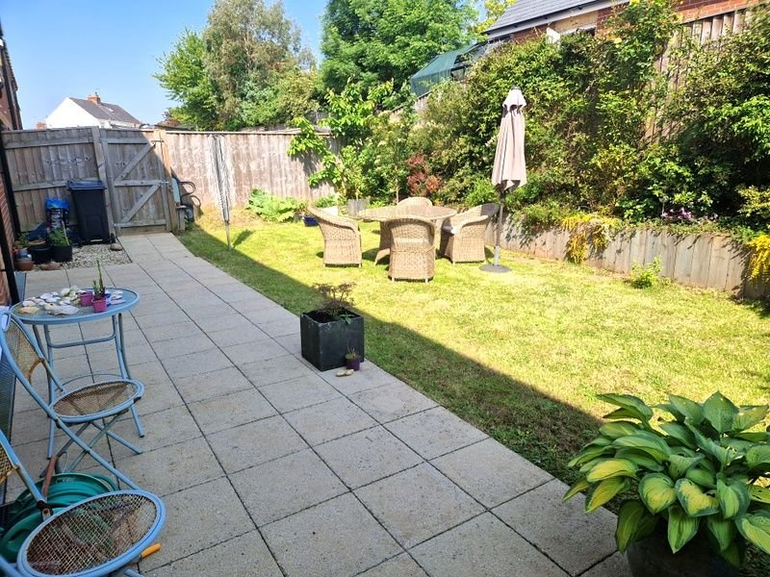
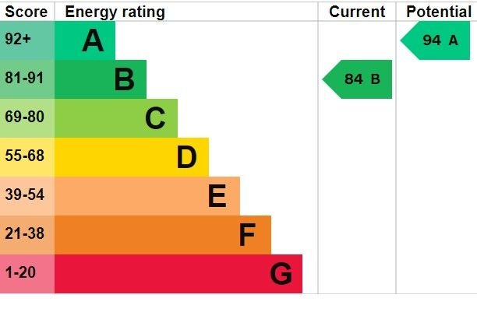
www.pennys.net
14 Flora Close, Exmouth, EX8 4FA
GUIDE PRICE £450,000
TENURE Freehold
A Most Spacious And Beautifully Appointed Semi Detached House Located In A Select Modern Development.
Reception Hall • Open Plan Kitchen/Dining Room • Utility Room •
Cloakroom/WC • Lounge •
Three Double Bedrooms • En-Suite Shower Room/WC •
Main Bathroom Suite • Gas Central Heating • Sash style Double Glazed Windows •
Front And Rear Gardens • Good Size Garage • Viewing Recommended •
Pennys Estate Agents Limited for themselves and for the vendor of this property whose agents they are give notice that:- (1) These particulars do not constitute any part of an offer or a contract. (2) All statements contained in these particulars are made without responsibility on the part of Pennys Estate Agents Limited. (3) None of the statements contained in these particulars are to be relied upon as a statement or representation of fact. (4) Any intending purchaser must satisfy himself/herself by inspection or otherwise as to the correctness of each of the statements contained in these particulars. (5) The vendor does not make or give and neither do Pennys Estate Agents Limited nor any person in their employment has any authority to make or give any representation or warranty whatever in relation to this property.
PENNYS ESTATE AGENTS
2 Rolle House, Rolle Street, Exmouth, Devon, EX8 2SN
Tel: 01395 264111 EMail: help@pennys.net

Slide 2
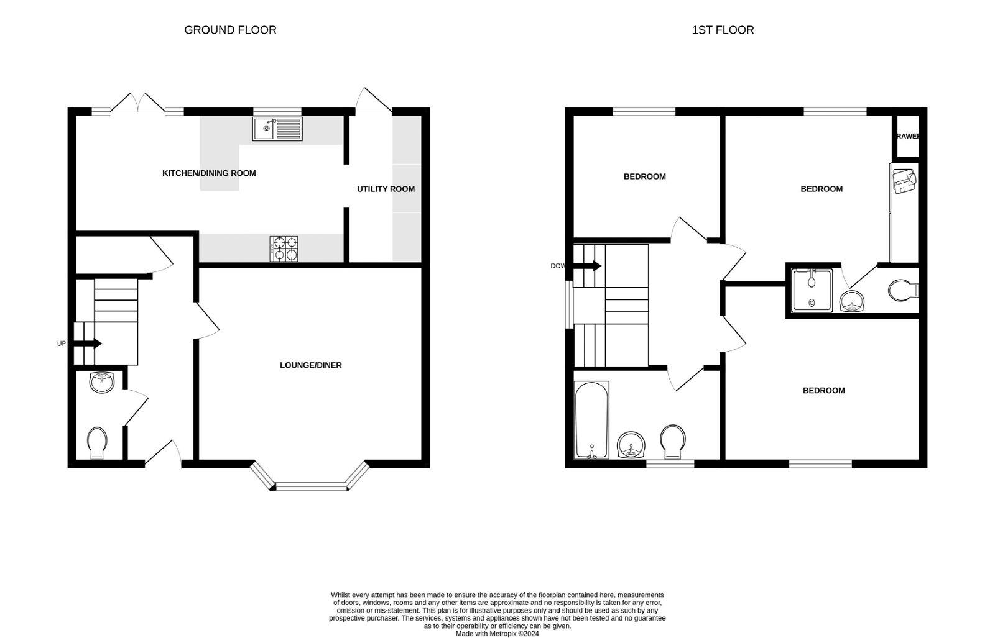
14 Flora Close, Exmouth, EX8 4FA
THE ACCOMMODATION COMPRISES: Pillared entrance canopy with outside light; front door leading to: SPACIOUS RECEPTION HALL: An impressive entrance to the property which opens through to the KITCHEN/DINING ROOM. turning staircase with glass balustrade rises to first floor landing; good size understairs cupboard; electric consumer unit; underfloor heating; wood effect flooring. CLOAKROOM/WC: Wash hand basin with mirror over in tiled surround; WC with push button flush; ceiling extractor fan; underfloor heating; wood effect flooring. LOUNGE: 4.8m x 4.42m (15'9" x 14'6") into bay window. Fitted with three double glazed sash style windows with wooden window shutters affording a tree lined outlook; TV point; telephone point; underfloor heating. KITCHEN/DINING ROOM: 5.74m x 3.23m (18'10" x 10'7") An impressive open plan room filled with Quartz work tops; matching splashbacks with inset one and a quarter bowl sink unit with hose style mixer tap and integrated drainer; range of cupboards and drawers; built in dishwasher; matching wall mounted cupboards with display lighting; space for upright fridge/freezer; underfloor heating; wood effect flooring; Nexus Range cooker with extractor hood over and full length glass splashback; double glazed sash window and double glazed sash doors with picture windows overlooking and opening to rear garden; TV point. UTILTY ROOM: 3.28m x 1.65m (10'9" x 5'5") Quartz worktops with splashbacks; inset sink unit with cupboards and plumbing for automatic washing machine beneath; upright larder style cupboard; Vailant gas boiler housed in matching unit; door to OUTSIDE; wood effect flooring; underfloor heating; ceiling extractor fan.
FIRST FLOOR LANDING: Access to roof space; radiator; ceiling downlighters. BEDROOM ONE: 4.19m x 3.43m (13'9" x 11'3") Double glazed sash style windows with wooden shutters to rear aspect; bespoke built in wardrobes and chest of drawer unit; radiator; telephone point. EN-SUITE SHOWER ROOM: 2.57m x 1.19m (8'5" x 3'11") Wash hand basin with tiled surround; WC with push button flush; double width shower cubicle with fixed rainfall shower head and detachable hose; chrome heated towel rail; radiator; ceiling extractor fan; shaver socket. BEDROOM TWO: 4.22m x 2.67m (13'10" x 8'9") plus wall recess ideal for wardrobe. Double glazed sash style window with wooden shutters to front aspect enjoying a tree line lined outlook; radiator; TV point. BEDROOM THREE: 3.2m x 2.64m (10'6" x 8'8") A good size bedroom with double glazed sash style window with wooden shutters to rear aspect; radiator; TV point. BATHROOM/WC: 3.2m x 1.73m (10'6" x 5'8") Spacious bathroom with bath; shower over and screen; wash hand basin; WC with push button flush; ceiling extractor fan; shaver socket; chrome heated towel rail; double glazed sash style window with wooden shutters; tiling to splash prone areas; ceiling extractor fan.
OUTSIDE: Lawned front garden with patio pathway to front door; block paved driveway to GARAGE. Shared side pathway and gate to rear garden. The rear garden comprises of a good size patio sun terrace, lawned garden with colourful shrub borders. outside tap. GARAGE: 6.25m x 3m (20'6" x 9'10") Up and over door; power and light connected; storage space in roof eaves; door to REAR GARDEN.

